Slide 1
Python Lists

Slide 2
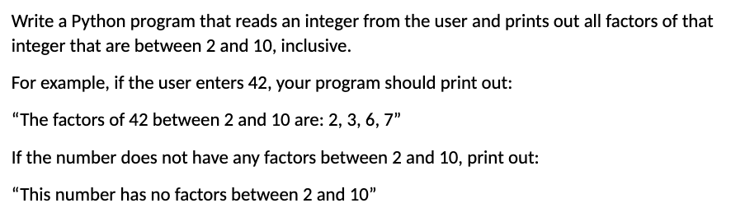
Taking Up Lab 3 Quiz
Notes:
Write a Python program that:
- reads an integer from the user and
- prints out all factors of that integer that are between 2 and 10,
inclusive.
For example, if the user enters 42, your program should print out:
“The factors of 42 between 2 and 10 are: 2, 3, 6, 7”
If the number does not have any factors between 2 and 10, print out:
“This number has no factors between 2 and 10”
Option 1: Manually (without loops)
Option 2: Concatenate a final string using for loop and range() method
Option 3: Append a list using for loop and range() method.

Slide 3
What is a list?
A list is a sequential collection of elements
Every list is enclosed in square brackets and separated by commas
Can store any data type as its elements
Can store more than one data type in the same list

Slide 4



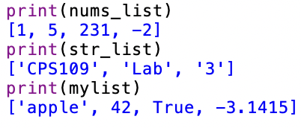
Examples of lists
Each element in a list is separated by commas:
You can store more than one data type in the same list:
You can print your lists:

Slide 5
Creating a list
You can create a list by placing your sequence of items separated by commas inside square brackets
my_list = [2, 4, 6, 8]
If I want to create a list without knowing what sequence of items will go inside my list, I can create an empty list
empty_list = [ ]

Slide 6
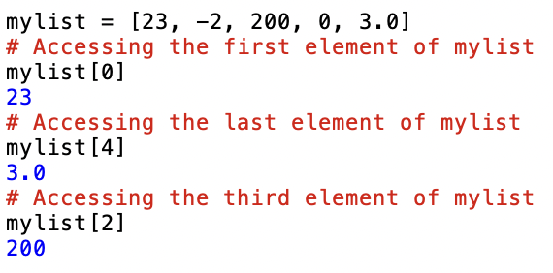
Accessing elements from a list
We can access any item in a list by referring to its index number
The index of an element refers to the position/order of that element in its list.
We use the index operator [ ] to access the element at a specified location.
The index must be an integer representing the position in the list we want to retrieve our element from.
In Python, lists start at position 0, not 1.
The index for last item in a list is always: # of elements in list - 1.

Slide 7
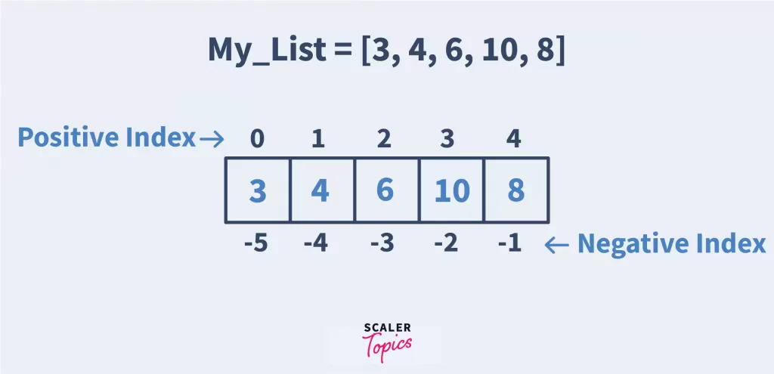
Negative indexing
We can also index backwards
Beginning from the last item of a list at index: -1
Ending at the first item of a list at index: -(# of elements)

Slide 8
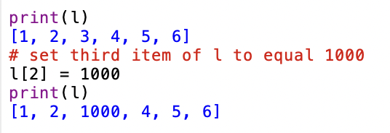
Changing an element in a list
You can change any position of the list by assigning a new value to the index of the element in list you wish to change.

Slide 9

Getting the Number of Elements (Size) of a List
We use the built-in Python method len() to get the length of any list.

Slide 10
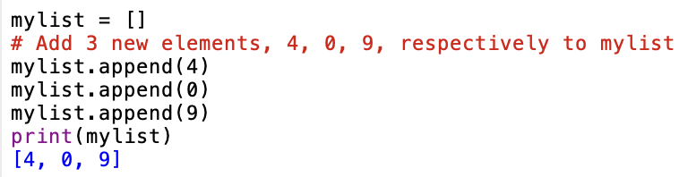
Adding an element to the end of a list
We can add an element to the end of a list using the append() method
Takes one argument: the value we want to add to our list
Changes the size (length) of a list without changing the position of any of the existing elements in list

Slide 11
Adding an element to the middle of a list
We can add an element to the any desired position of a list using the insert() method
Unlike append(), the insert() method requires two arguments: the position (index) where we want to insert our value, and the value we want to insert at this position, respectively
This means that the starting index of every element in the original list, starting at the index we are inserting at, will increase by one.
Example on Spyder!

Slide 12
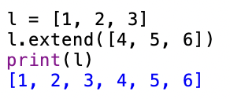
Add multiple elements to the end of a list
You can add multiple elements to the end of a list at once using the extend() method

Slide 13
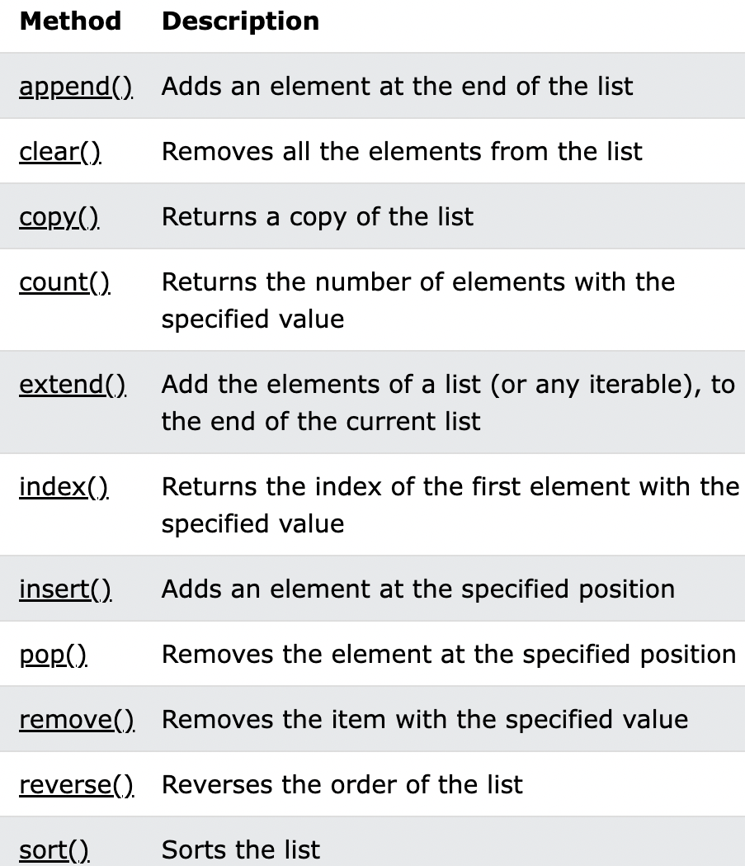
There are so many useful python list methods!!

Slide 14
Helpful sources - list
Python Lists:
https://www.geeksforgeeks.org/python-lists/
Useful List Methods:
https://www.w3schools.com/python/python_lists_methods.asp

